Slide 1

Bell Work: Solve
$${1.) 2(3)}^{3x−2}+16=48$$
$${2.) 5log}_{2}\left(x+3\right)−2=48$$

Slide 2
From Last Time
Page 473 #1–5, 7–23 (odd), 33–41 (odd)

Slide 3
Pre-calc trig
Day 77

Slide 4
7.6 Natural Logarithms
Objectives: To evaluate and simplify natural logs
To review properties

Slide 5
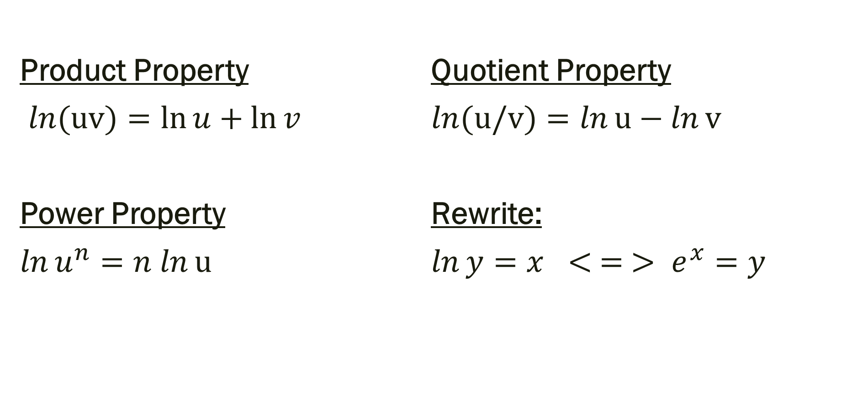
Properties with Natural Log
Product Property Quotient Property
$\ln{(uv)}=\ln{u}+\ln{v}$ $\ln{(u/v)}=\ln{u}−\ln{v}$
Power Property Rewrite:
$\ln{u^{n}}=n ln{u}$ $\ln{y}=x < = > e^{x}=y$

Slide 6
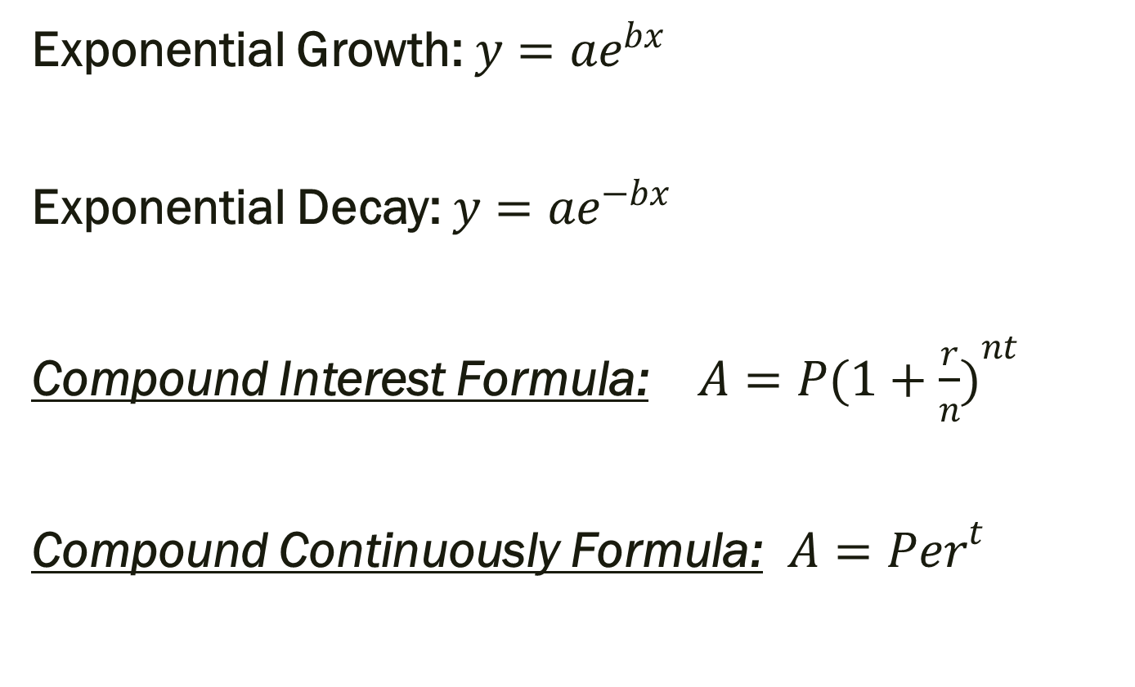
Formulas applied to Natural Log
Exponential Growth:${y=ae}^{bx}$
Exponential Decay: ${y=ae}^{−bx}$
Compound Interest Formula: $A={P(1+\frac{r}{n})}^{nt}$
Compound Continuously Formula: $A={Per}^{t}$

Slide 7
Example: Write as a single log.
2 ln 4
ln 18 – ln 10
2(ln 8 + ln 5)

Slide 8

Example: Solve
ln 9x = 4 2 ln (9x–15) – 10= 8
$e^{6x}=35$ ${2e}^{5x−1}+4=18$

Slide 9
For Next Time
Page 480 # 5–8, 11, 13, 21, 29, 31, 35, 38, 39

